Slide 1
IoT Based Home Automation system with Google Assistant
Group – 1
ID -021221043
ID-021221050

Slide 2
Table of contents
Circuit Diagram & Implemented Project
01
02
Features & description
Components & cos estimation
03
04
Advantages & conclusion

Slide 3
Introduction
Discover the future of home living with our IoT-based Home Automation System, enhanced by Google Assistant. Control your space seamlessly using voice commands and experience unparalleled convenience and connectivity. Welcome to smarter living.
Example Text : Get a modern PowerPoint Presentation that is beautifully designed. I hope and I believe that this Template will your Time, Money and Reputation. Get a modern PowerPoint Presentation that is beautifully designed. I hope and I believe that this Template will your Time, Money and Reputation. You can simply impress your audience and add a unique zing and appeal to your Presentations.

Slide 4
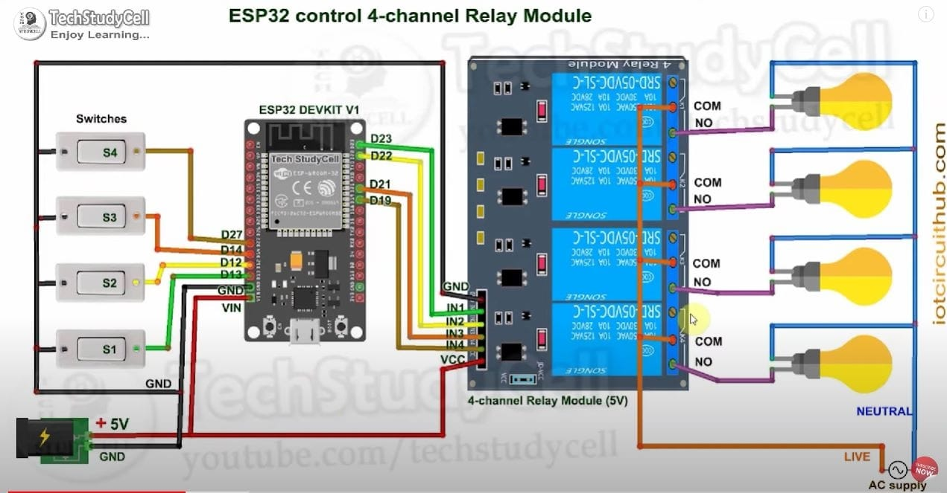
Circuit Diagram

Slide 5
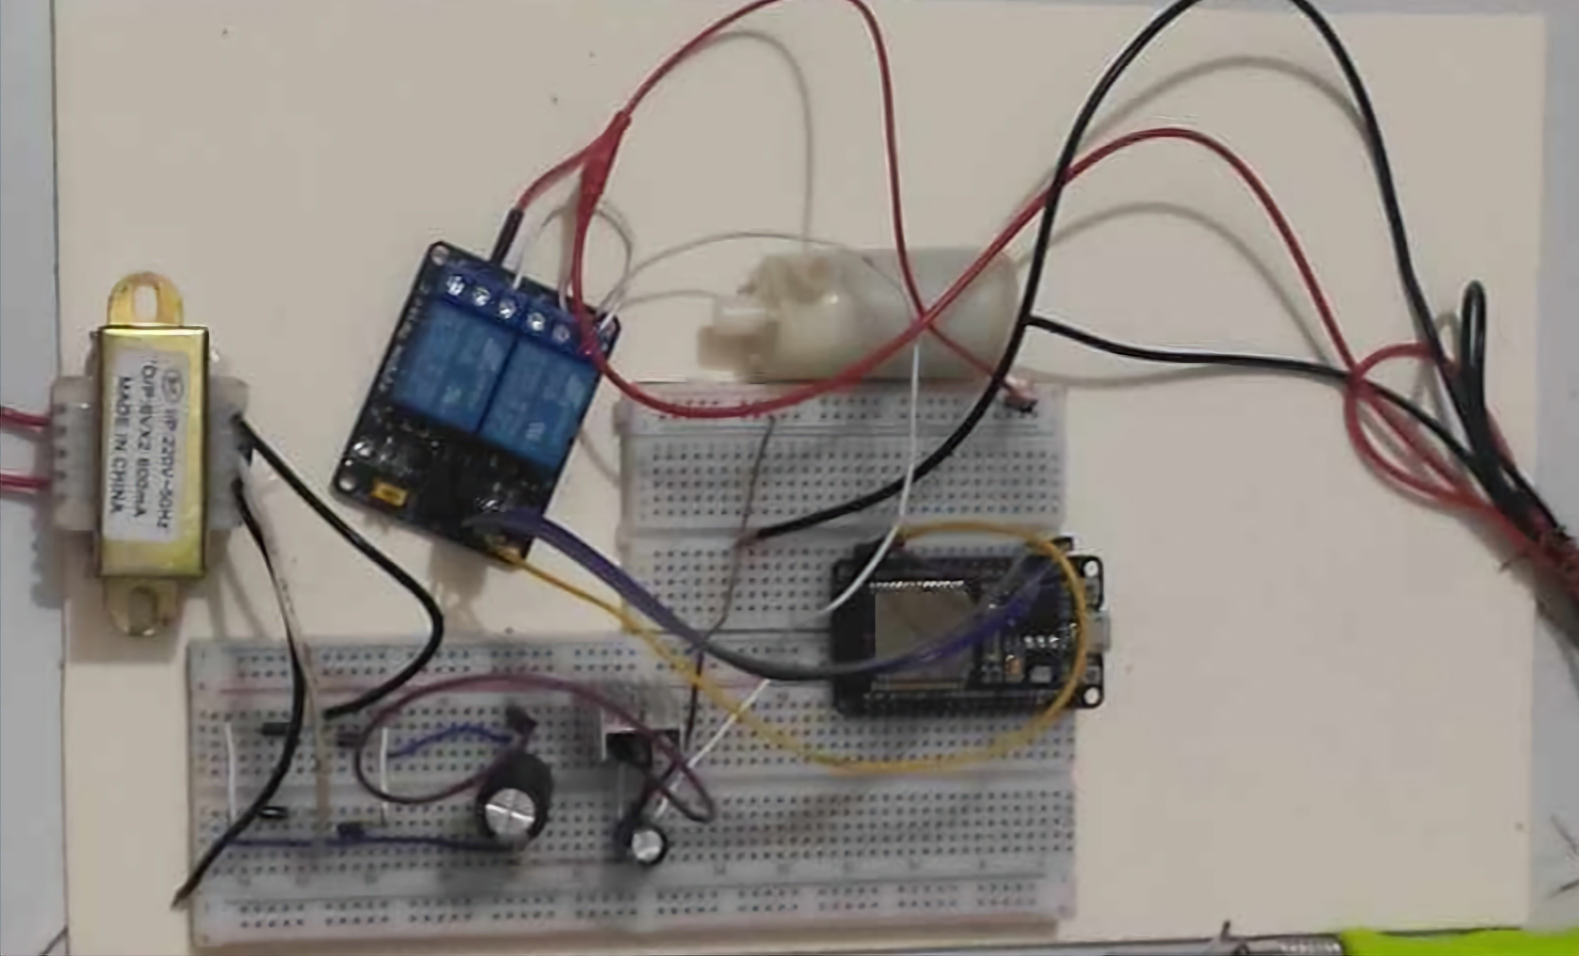
Implemented Project

Slide 6
Description
The project is an IoT based home Automation system that can control up to four devices using both switches and assistant google The system is made by microcontroller NodeMCU ESP32,relays,switches and a sinric pro account >The nNodeMCU is connected to the inter via wifi and uses sinric pro API to control relays.A rectifier circuit giving 5v to microcontroller. IoT-based Home Automation System combines hardware components like the NodeMCU ESP32, relays, switches, and a rectifier circuit with cloud-based services like Sinric Pro and the Google Assistant. This fusion of technologies allows you to control your home devices remotely through voice commands or physical switches, offering both convenience and flexibility. Whether you're at home or away, you have the power to manage your living space with ease.

Slide 7

FEATURES
The system can control 4 devices at a time but here we used 2 devices.
Add Text
Easy to set up and use and cost friendly.
The system easy to control with voice , google home or Alexa.

Slide 8
Components and costs
Total Cost
1199 BDT
ESP 32 -400BDT
4 Channel Relay =180 BDT
Switch 2x =40 BDT
Transformer =230BDT
Diode 4x= 4BDT
Capacitor = 35 BDT
LM7805 = 10BDT

Slide 9

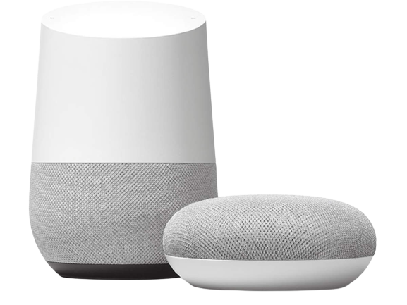
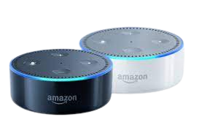
Advantages
The system can make your home more convenient and comportable
The system can help you save energy
The system can add an extra layer of security to your home
Cost friendly can be installed at 10 to 20 k BDT whereas google and amazon giving the service around 100k BDT.
Conclusion
This IoT based home automation system is great way to make home more convenient ,comfortable and secure.It is easy to use and can controlled remotely from anywhere in the world. If you are looking for automating your to being more futuristic this system is a great option to choose.

